Slide 1
Deliverable 1
Ants: Colony Wars
Sprockets and Sprites

Slide 2
Game Design
Ants: Colony Wars is an artillery game with a 2D perspective that uses turn based platforming and combat, the gameplay is broken up into two stages these being:
Stage 1 “Preparation” – Stage 1 has the player guiding larvae units throughout a linear map, many obstacles block the players progress as they will damage or kill their units, In order to avoid the obstacles the player will use a cursor to click on objects within the environment to create alternative routes for the units to take. The main objective of this stage is to reach the end of the level with as many units as possible.
Stage 2 “Combat” – Stage 2 has the player engage in turn based, artillery combat. The player takes control of unique units that have their own playstyle to combat the opponent. These units vary from the “flying” ant which has a smaller health pool but is able to deal more damage to the “Soldier” ant which has a larger health pool but does not deal as much damage. The units will be able to freely move around the environment once it is their turn and fire at the enemy. The players take turns one unit at a time during this stage. Depending on how many units survive stage 1 the player will receive supplies such as health and ammo, the amount of supplies received is based upon how many units were able to reach the end of stage 1.
Notes:
Our games genres are:
Puzzle Platformer Game (for the first stage)
Turn-Based Tactical Artillery Game (for the second stage)

Slide 3
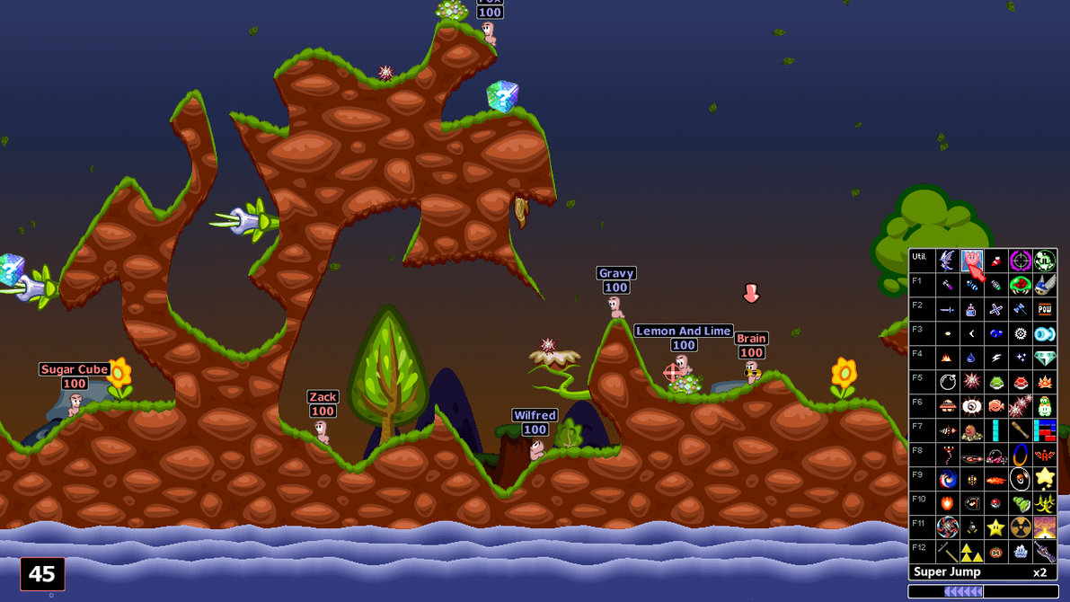
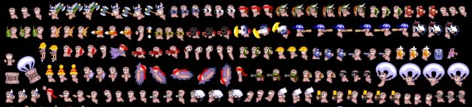
Game Design - Inspiration
Worms game series
The Worms game series has inspired us to produce a demo for an artillery shooter that is simple, this is because the series has many successful artillery games whose success is primarily due to the simplicity of the gameplay combined with an interesting theme. We will keep our demo simple by only including simple mechanics such as movement and shooting.
We’ve also been inspired by the 16-bit art style of the original worms and lemmings, both for the simple design and also as a reference to the games.
Notes:
Mention how we used worms franchise for general combat above W.M.D, then how we used W.M.D for classes.
Worms influenced the overall art style and gameplay of the game.

Slide 4
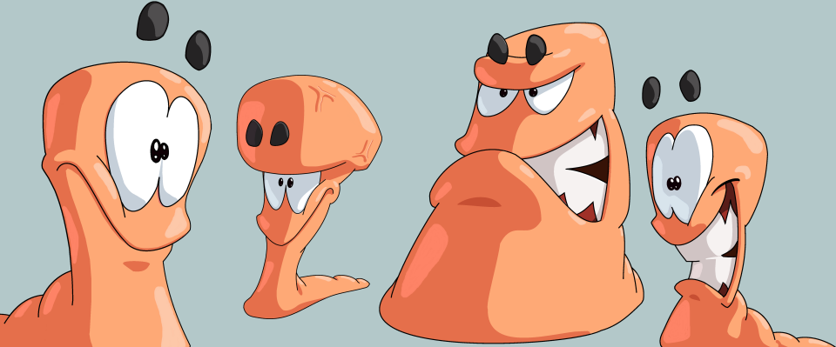
Game Design - Inspiration
Worms W.M.D
Our game was inspired by the unique unit types from Worms W.M.D, given how successful Worms W.M.D was on steam we decided to note how they used different unit types in their combat. By using Worms W.M.D as inspiration we were able to design unique units such as the flyer ant to keep the combat engaging and cause the player to strategically plan their movements and make use of the advantages and disadvantages of each unit type.
Notes:
Mention how we used worms franchise for general combat above W.M.D, then how we used W.M.D for classes.
Worms influenced the overall art style and gameplay of the game.

Slide 5
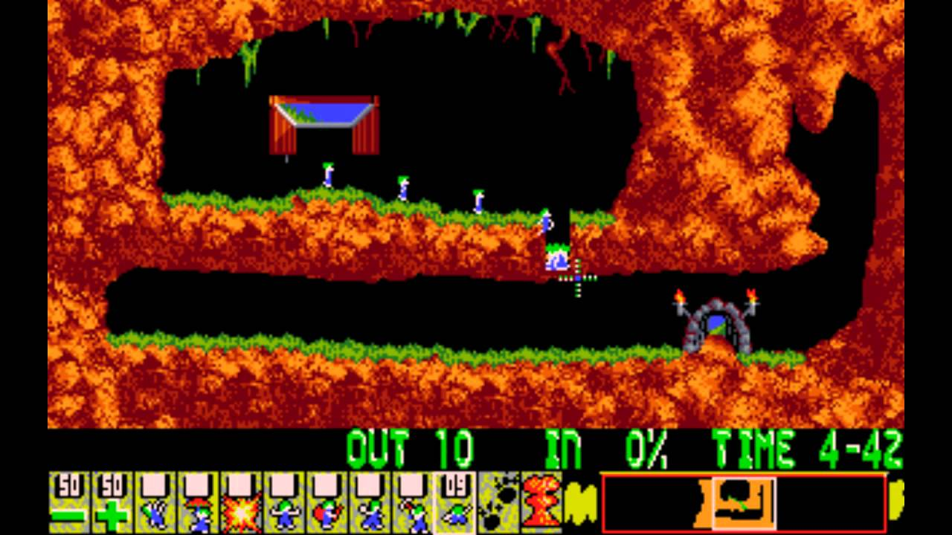
Game Design - Inspiration
Lemmings
The first stage in our game was inspired by the overall gameplay of Lemmings, one of our unique selling points was to combine both genres of artillery combat and platforming. As a result we have chosen to use Lemmings as inspiration on how to design levels that contain numerous obstacles to create a challenging and intuitive platforming experience.

Slide 6
Realising the Design - Programming
In order to realise the design from the programming perspective we would first reference the original idea, for example the idea of turn based gameplay.
Once we understand how the idea is supposed to work we will attempt to create the feature in the Unreal Engine whilst referring to forums and videos where necessary.
Thirdly we will prototype the idea again using the information gained from experimentation and researching the idea online.
Once we are content with the feature we will continue to test and refine it within the Unreal Engine to make sure that it successfully works.

Slide 7
Realising the Design - Art
In order to realise the design from the artistic perspective we will first create concept art, this will allow the team to get an understanding on how each aspect of the game should look.
Once the concept art is done we will then begin on creating the art digitally whether that is scanning the physical versions of the art or creating the art again using image creation programs such as Photoshop.
With the digital art created we will then import it into the Unreal Engine, the main method we will use to import is the flipbook method. This will play each image in a sequence resulting in an animation.
After the images have been imported we will then refine where necessary, we will need to refine the frames per second on certain images to make each animation appropriate in length.

Slide 8
Technical Challenges - Programming
To implement multiplayer into our game, we watched tutorials online and searched through the Unreal forums to figure out a way to approach it. We began by creating one character who was able to move, jump and fire. Once this was done we created other characters who were clones of the original character. We decided to use “flip flop branches” so that when one players turn ended, the other players turn began.
A problem with the turn based firing mechanic was that when firing mid-jump the players turn would end, the sprite would stop being affected by gravity and the walking animation would continuously play.
To fix this issue we disabled the players ability to fire in mid air and we also added a blueprint that activated when the sprite fires that stops all current animations.
Bullet arc
Destructible terrain

Slide 9
Technical Challenges - Art
In order to import the sprites into the Unreal Engine we will create a sprite sheet via Photoshop. This will ensure that each movement within our game will have an appropriate animation.
The technical challenge with this is formatting the sprite sheet so that Unreal will automatically detect and import each sprite. Without this we will have to manually import each sprite which will consume time.
In order to animate each sprite we will need to create a Flipbook animation in the Unreal Engine, this makes each image play in a sequence which results in an animation.
The technical challenge with this is modifying the timeline of the flipbook to make each animatation appropriately timed.
When creating the background we will make use of several layers to manipulate the background so that it moves as the camera moves.
When we first started making the level we encountered a bug with the table meshes collision box, this meant that the player hovered above the seats at the same level as the table top instead of falling down to it. We solved it by recreating the mesh in Maya and importing that into Unreal.

Slide 10
Gameplay Issues
Linking the stages together
Making the game balanced
…

Slide 11
Planning and Production Methods
Gantt Chart.
Trello – Used to create a pipeline of work to be done.
Burn down chart – Allows the team to see how much work is done vs how much we need to do.
Version control (Github) – Allows the team to all work on the game at once in real time.
Agile development. – By having regular meetings the team is able to provide support and work together
Sprint goals. – Provides the team with numerous goals to reach and helps to understand where we are in development.

Slide 12
Evaluation
As a team we will need to work on our communication, currently we have one designated meeting on Wednesday each week. If needed we also meet up during the week and on weekends at the Library to continue work.
One issue that has become apparent is that not every member attends the meetings or comes to the Library resulting in a knowledge gap. To solve this we update all of our team members on what was done and what they need to do online.
A second issue that has become apparent is that the work ethic decreases when team members are at home, this means that as a team we do not produce as much work as possible. To solve this we arrange meetings outside of everyone's housing such as the Library and computer rooms located inside the university.
Currently the tech demo is lacking the visual aspects of the game such as the menu or sprites. This is because we have focused on the more time consuming parts of work such as the multiplayer and firing mechanics.
Due to the oncoming deadlines we have began to meet up on a more regular basis to make sure more work is done, if this continues into 2018 we will be able to create the visual elements of our game.
If we maintain this work ethic we can produce enough of our game in a refined manner to make sure that the tech demo will demonstrate a variety of technical elements of our game, this will result in our tech demo being successful.

Slide 13
Conclusion?

